Slide 1

Parcel project
Emir Açikgöz
George Ottens
Ismail Böyükşimşek
Laurine van de Stolpe
Rick Hagenaar
Idriss Bensaga

Slide 2
Group members
Rick Hagenaar (software engineering)​
Emir Açikgöz (Information security)​
George Ottens ( aviation engineering)​
Ismail Böyükşimşek (Information security)​
Laurine van de Stolpe (Applied Mathematics )​
Idriss Bensaga (Buisness and data Managment)​

Slide 3
Content
Introduction
What have we accomplished
Conclusion
Questions

Slide 4
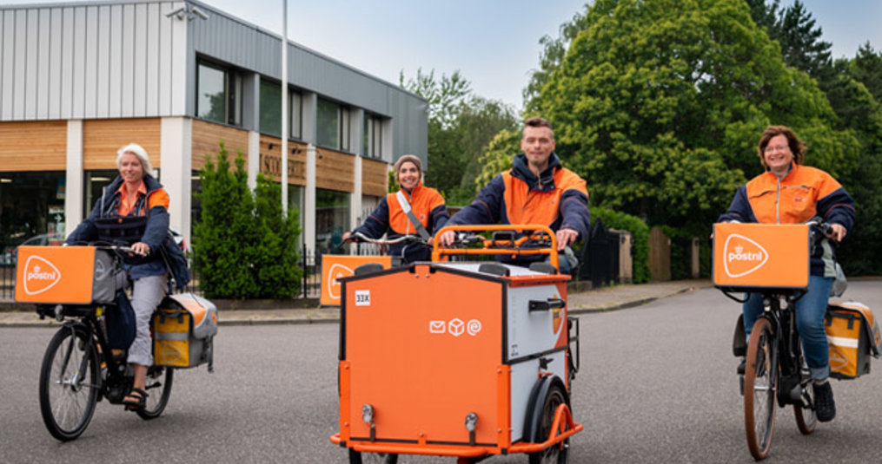
Introduction
Product owner: PostNL
Assignment: Predicting the amount of processed packages
Data: amount of daily packages processed, for 300 customers, for 5 years​

Slide 5
What have we accomplished
Multivariate Linear Regression model
SARIMA
Paper

Slide 6
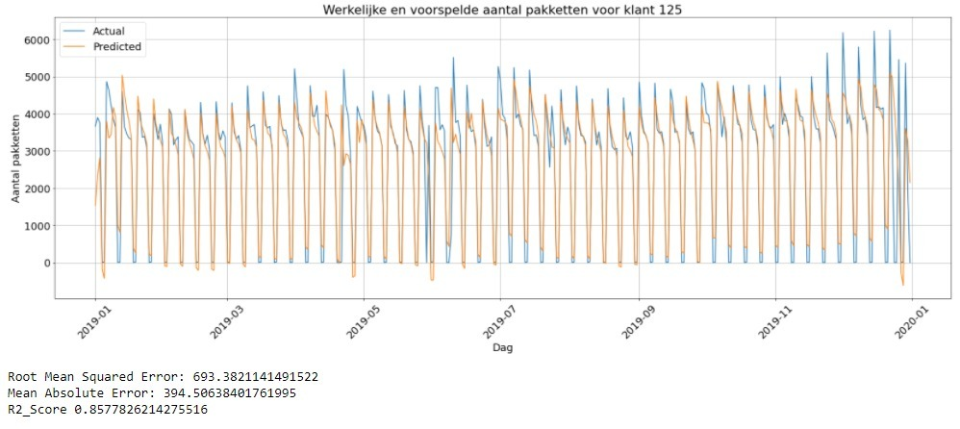
Multi variabele lineaire regressie

Slide 7
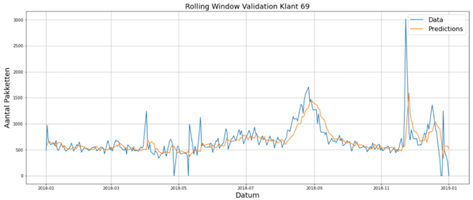
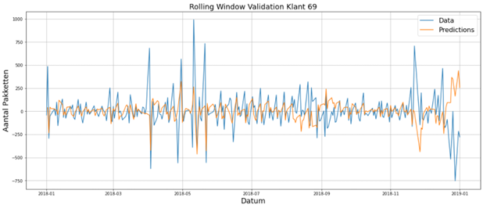
SARIMA
RMSE: 602
RMSE: 155

Slide 8
Conclusion
Multivariate Linear Regression model
SARIMA

Slide 9

Questions

